Slide 1
AI Project Presentation
Subtitles Generator

Slide 2
Subtitles Generator
I made a subtitles generator using the built-in Speech Recognition library and Google Speech API.
I am using monotype audios with extension WAV, FLAC, AIFF, as input.
After speech recognition of audio source and converting that speech into text, I wrote the text on to an SRT file using file handling.

Slide 3

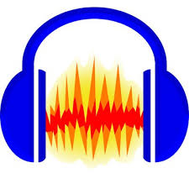
Dataset
I took some audios from google and some of them I recorded by myself.
I downloaded one video from YouTube and convert it into audio using a VLC media player and after that converted all those audios into monotype using Audacity.

Slide 4
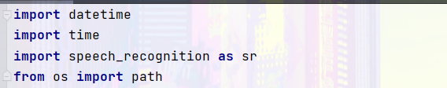
Libraries
Libraries that I used are:
I used the DateTime library for setting time in the SRT file.
I used the time library just for creating some delay.
I used the main speech recognition library for recording and recognizing speech from an audio file.
At last, I used OS and path for inserting audio files in the program.

Slide 5
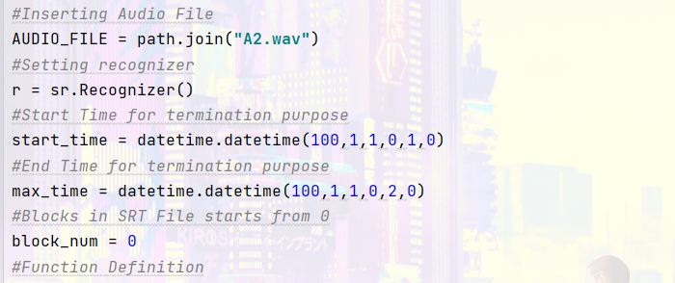
Initializing Important Variables
First, I inserted an audio file in AUDIO_FILE variable.
Then initialize sr.recognizer() in variable r.
At last, I set the start and end times of the SRT file and SRT file’s Block initial number as 0.

Slide 6
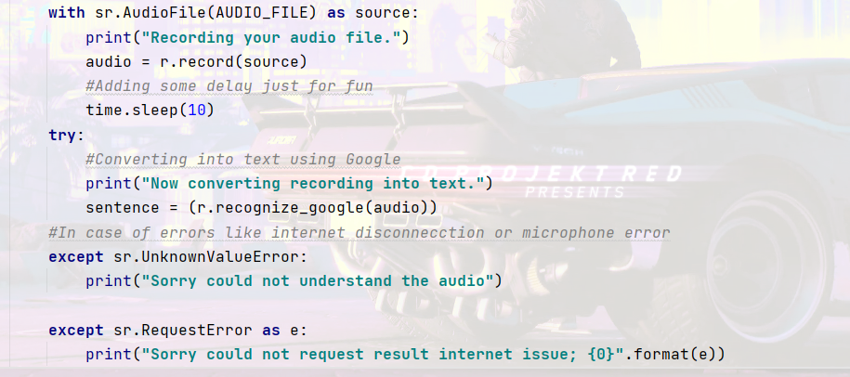
Main Function
I saved converted text into a global variable.
Them I recorded audio from an audio file in the audio variable and after that recognize it by using Google Speech API and save the generated text into a global variable that I created at the start.

Slide 7
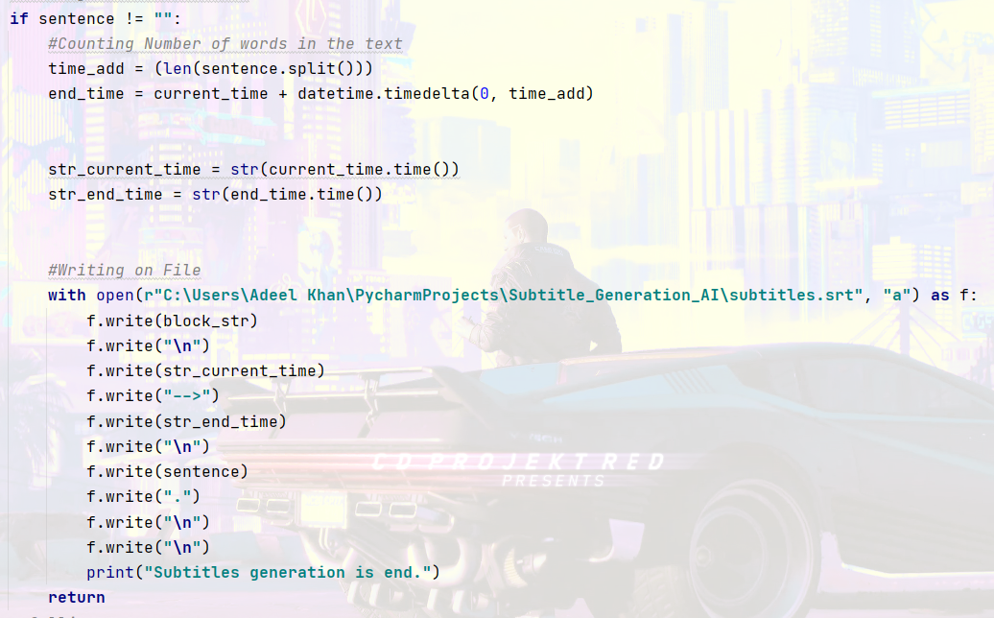
After that, I set the current and end time according to audio length and convert them into strings to write on the SRT file.
At last, I wrote the text onto my SRT file according to the block and time I set initially.

Slide 8
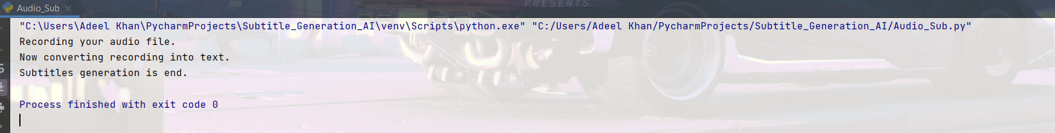
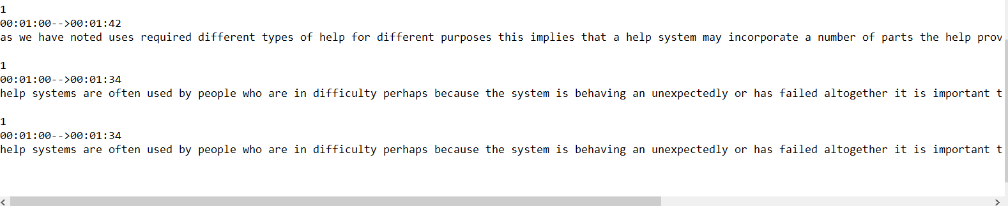
Output
This is the output that I got from it.
Compiler Output:
SRT Output:

